Slide 1


Slide 2
Why would you want to track planes
You’re a plane spotter
You wonder “What’s that plane and where’s it going?”
To gain access to REAL TIME global plane tracking
Because (like me) you’re bored and had a spare pi

Slide 3
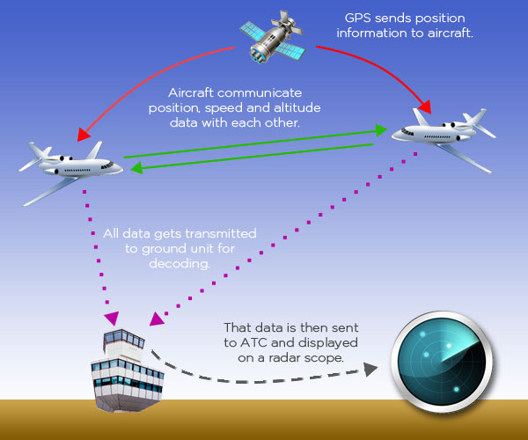
How it works (radio side)

Slide 4
Receiving ADS-B with Linux
RTL-SDR, repurposed freeview USB adapters
ADS-B is 1090MHz, well within range of all RTL-SDR adapters
Suitable antenna (can be DIY, cut original antenna to length, or purchased)
Ideally add a filter, similar in price to the SDR
Dump1090 software (or variant)

Slide 5
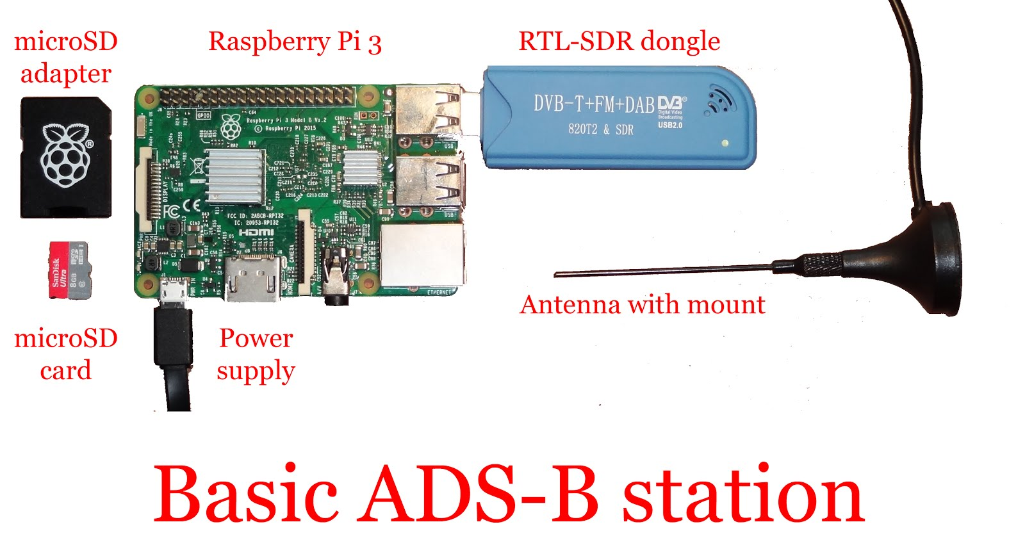
Basic ADS-B receiver Overview

Slide 6
Getting it working the EASY way
Piaware image running on Raspberry Pi
Benefit of reasonable community support, well tested and easy to use.
After writing to SD card, simply “claim” the “site” on the flightware control panel and you are up and running
Based on Raspbian Wheezy, some libraries are old, makes tweaking more work than a DIY solution

Slide 7
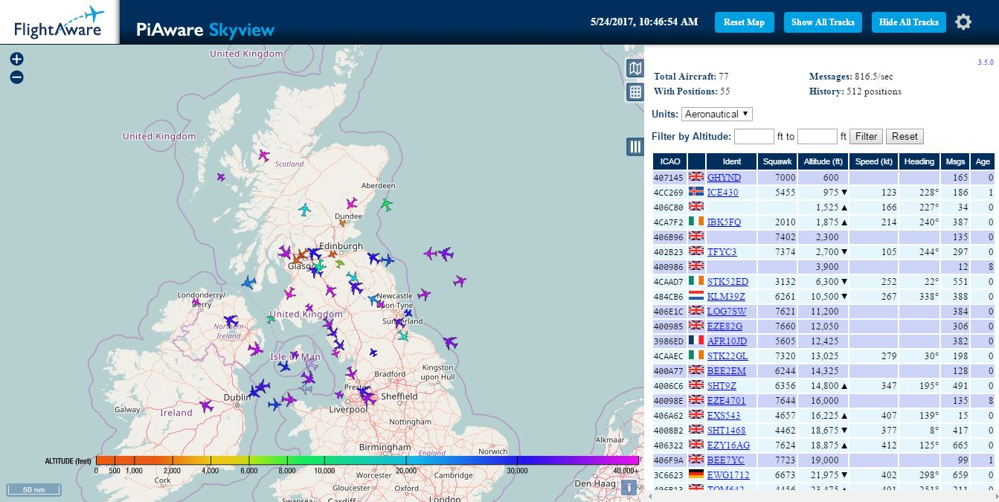
Piaware Skyview

Slide 8
Getting it working, the tweakable way
Distro of your choice (I’m using Raspbian on Pi3)
Dump1090-Mutability (fork of dump1090 software)
Web server of your choice (I’m using lighttpd)
Easy setup script available (for Debian based distros only)

Slide 9
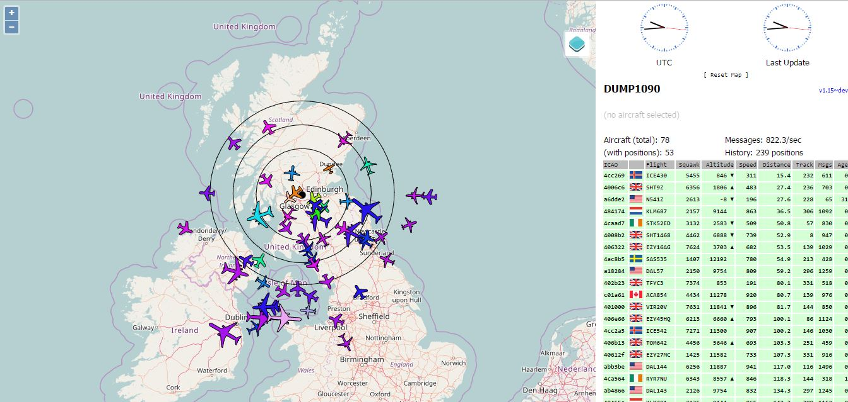
Dump1090- Mutability

Slide 10
Hacks to Dump1090-Mutability
Heatmap, showing the most common positions planes report from
Rangemap, showing the absolute maximum distance planes have reported from, at varying altitudes
Ability to log all reported positions, or feed to other programs

Slide 11
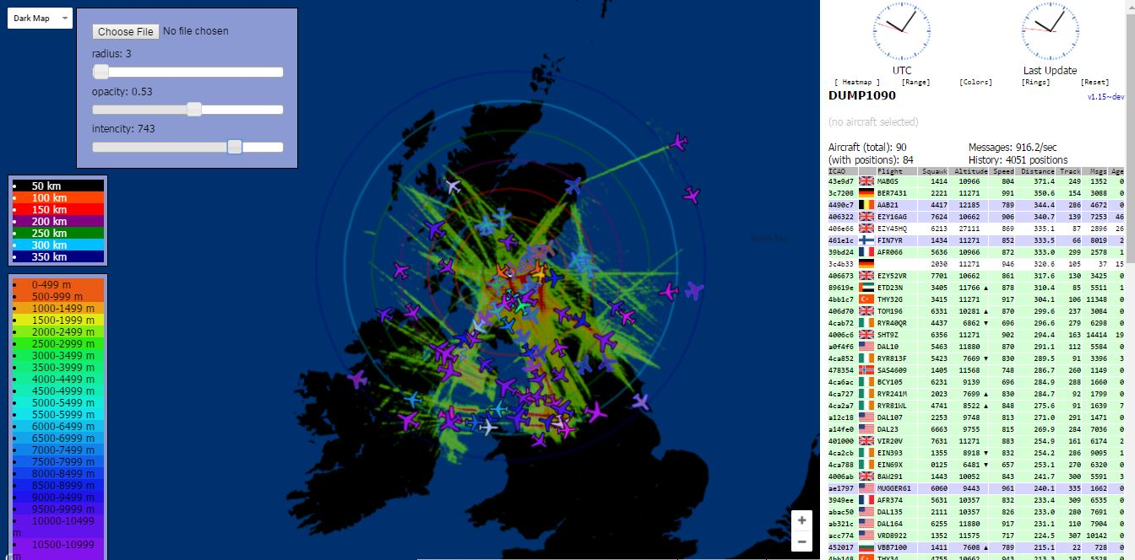
MutabilityMOD Heat map

Slide 12
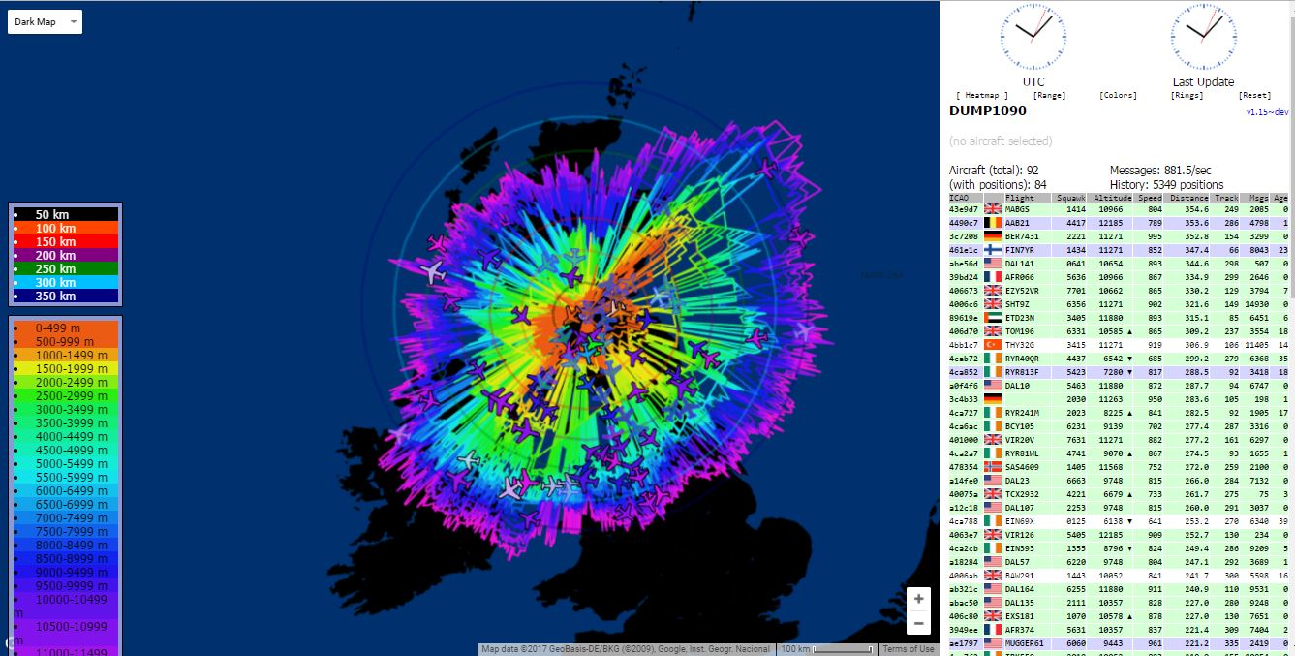
MutabilityMod Range

Slide 13
Feeding data elsewhere
Data can be fed to multiple plane tracking sites at once
ADSBExchange setup script feeds to:
  Flightaware
  Flightradar24
  Planefinder
  ADSBExchange
Data can be fed to other programs on your network – Introducing @AboveCumbernauld Twitter bot

Slide 14
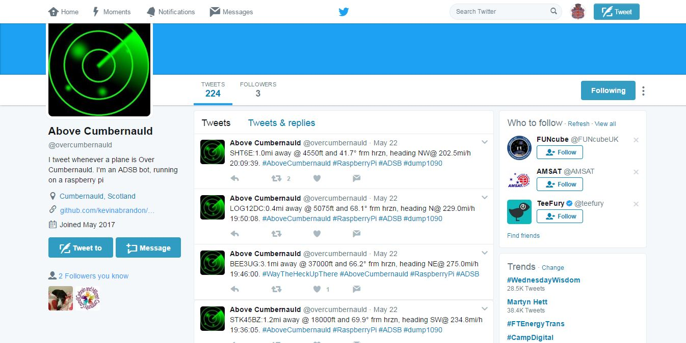
Feeding data elsewhere
CONTINUED

